Slide 1
Practice Lab:
This Practice Lab is dependent on Discussion Unit 7560, where most of the objects we create in this lab were introduced.
This Practice Lab requires a working DSE system, with DSE Analytics enabled.
Because of the dependency on the "dse fs" utility, this Practice Lab requires a ssh(C) prompt on at least one node operating DSE Analytics.
DSEFS, Configure and use
Notes:
The goal of this Practice Lab is to configure and use DSEFS.

Slide 2
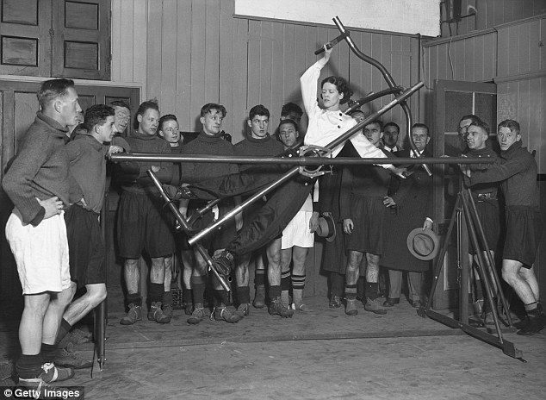
Challenge 1: Prerequisites
Prerequisites:
Instructions are provided for Linux
We will operate below recommended settings; 1 OS node only, minimum 8 GB RAM, 12 GB RAM preferred
That you have an operating single node DSE Analytics cluster.
All work done as ‘root’
Notes:
To complete this Practice Lab, the following is assumed:
All prerequisites and conditions as listed above.
All work is expected to be executed on one OS node (instructions are written for Linux).
Because of resource constraints, it is expected you are running a single DSE Core node (no Graph, Yes Spark, Search) on this single OS node.

Slide 3
Challenge 1: Examine and/or fix dse.yaml
dsefs_options:
enabled:
keyspace_name: dsefs
work_dir: /var/lib/dsefs
public_port: 5598
private_port: 5599
data_directories:
- dir: /var/lib/dsefs/data
storage_weight: 1.0
min_free_space: 5368709120 # Change to 1024 for dev
Notes:
Relative to this challenge:
Find the dse.yaml.
Check min_free_space, and/or set to a very low value; 1024
If changes are made, reboot this DSE node/cluster.

Slide 4
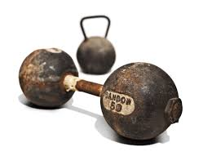
Challenge 2: Scala, Scala REPL
Using the Scala REPL:
val rows = sc.textFile(
"file:///opt/stores_db/7545_HelloWorld.csv")
rows.collect().foreach(println)
rows.saveAsTextFile(
"dsefs:///tmp/7545_HelloWorld.csv")
Notes:
Relative to this challenge:
Using "dse spark" (the Scala REPL), execute the command above-
Create a file to copy into DSEFS
Confirm your work on the next page.

Slide 5

Challenge 3: "dse fs"
Confirm the presence of the newly created file
Cat same
Run other POSIX/FS commands
Notes:
Relative to this challenge:
Confirm the presence of the file created on the previous page; cat it.
Runm experiment with other POSIX filesystem commands.

Slide 6

Practice Lab:
Lessons Learned
Notes:
Discuss what worked well, poorly, from the Practice Lab.

Slide 7
End of Unit:
Notes:
End of Practice Lab-

